Slide 1



UNIT 3;
The world around me
Congratulations, Nigel!

Slide 2
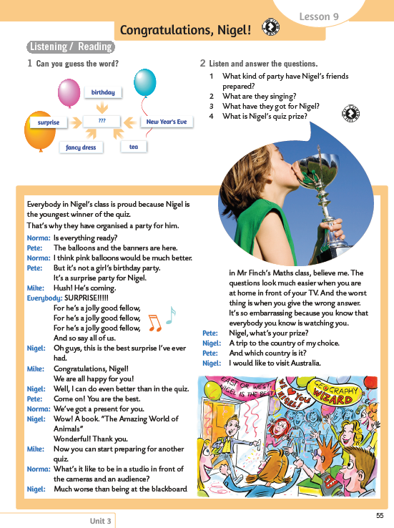
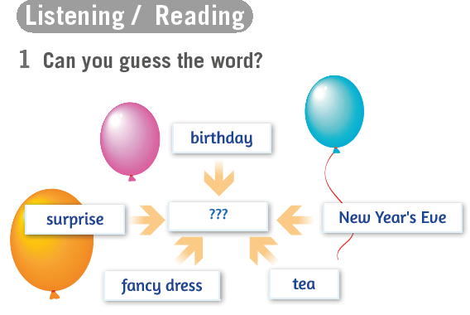
Open your book, page 55.
Think. Can you guess the word?
PARTY - zabava
What is your favourite kind of party and why?

Slide 3
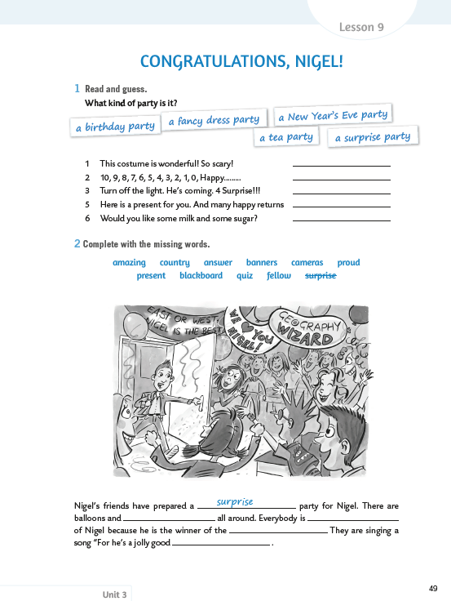
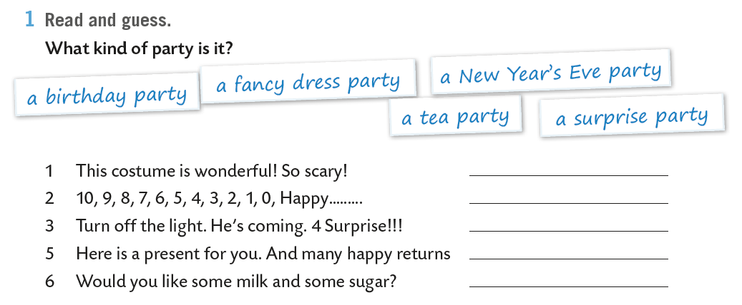
Open your exercise book, page 49.
Read and guess. What kind of party is it?
Pročitaj rečenice i pokušaj odgonetnuti o kakvoj se zabavi radi?
a fancy dress party
a New Year’s Eve party
a surprise party
a birthday party
a tea party

Slide 4





Think of all the things you need for a party!
music
balloons
PARTY
What is a BANNER?
BANNER = transparent

Slide 5
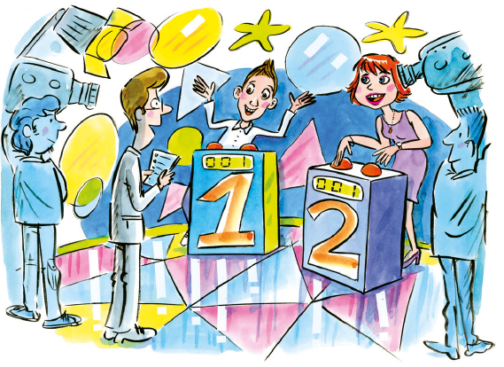
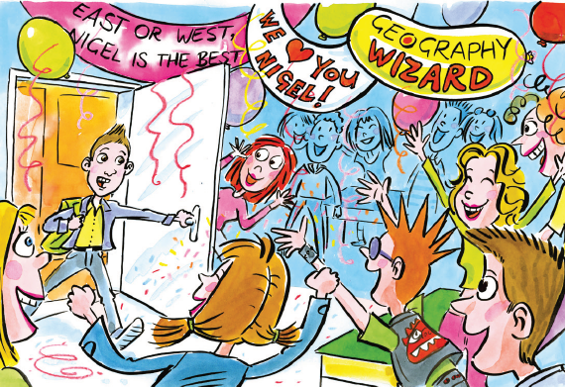
Do you remember the quiz from our last lesson?
Who is the winner of the quiz "What a wonderful world!?”
Nigel is the winner of the quiz What a wonderful world.
How old is he?
He is 11 years old.
Whose classmate is he?
He is Mike’s classmate.
Open your book, page 55.
Look at the banners, and translate them.

Slide 6
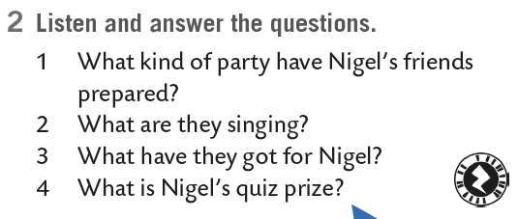

Listen and answer the questions.
https://www.e-sfera.hr/dodatni-digitalni-sadrzaji/d874387f-a20c-4100-9055-6481369241f5/assets/audio/25_lesson_9_nigel_s_party.mp3
Nigel’s friends have prepared him a surprise party.
They are sing a song ”For he’s a jolly good fellow!”.
They got him a book ”The amazing book of animals”.
Nigel’s quiz prize is a trip to the country of his choice.

Slide 7
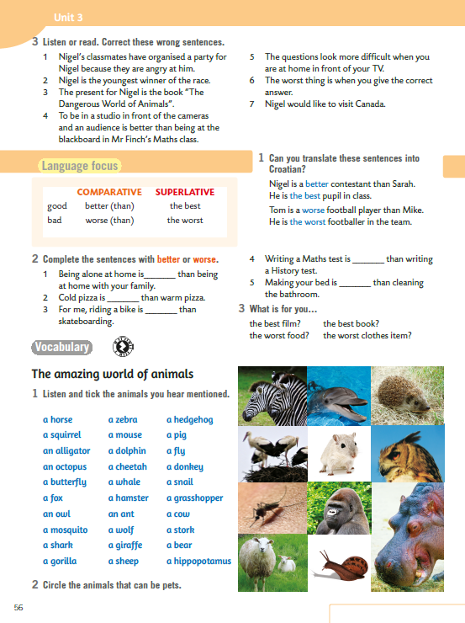
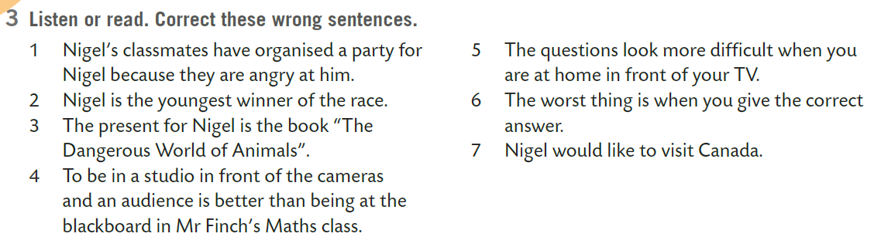
On the next page....
Listen or read. Correct these wrong sentences.

Slide 8
1 Nigel’s classmates have organized a party for aNigel because they are proud of him.
2 Nigel is the youngest winner of the quiz.
3 The present for Nigel is the book “The Amazing World of Animals”.
4 To be in a studio in front of the cameras and an audience is worse than being at the blackboard in Mr Finch’s Maths class.
5 The questions look easier when you are at home in front of your TV.
6 The worst thing is when you give the wrong answer.
7 Nigel would like to visit Australia.
"For He's A Jolly Good Fellow" is a song which is sung to congratulate a person on a significant event, such as a retirement, a promotion, a birthday, the birth of a child, or the winning of a championship or a sporting event.

Slide 9
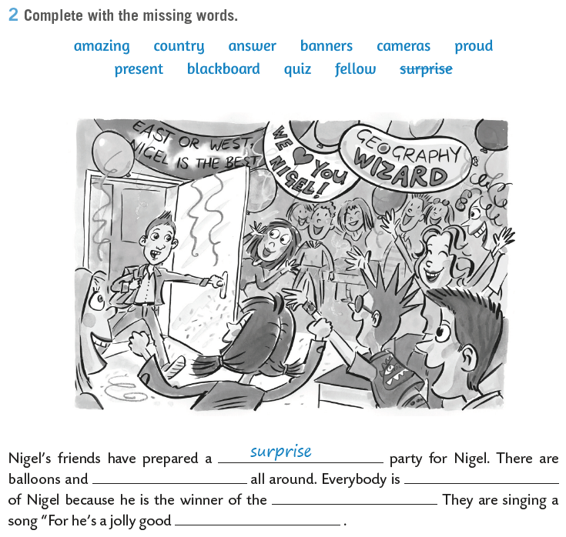
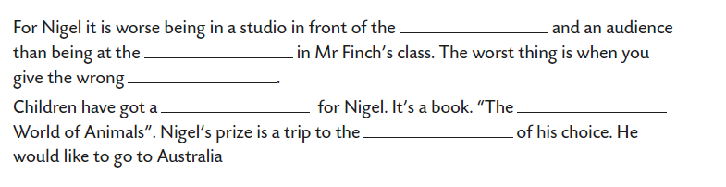
Open your exercise book, page 49.
Complete with the missing words.
cameras
blackboard
answer
present
amazing
country
banners
proud
quiz
fellow

Slide 10

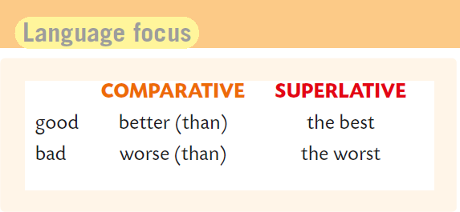
Go back to your book, page 56.
Some adjectives have irregular comparative and superlative form.
Do you know the meaning of these words?
Znaš li što riječi iznad znače?
dobar bolji najbolji
loš lošiji najlošiji
Pronađi sve primjere u tekstu na 55. stranici udžbenika!

Slide 11
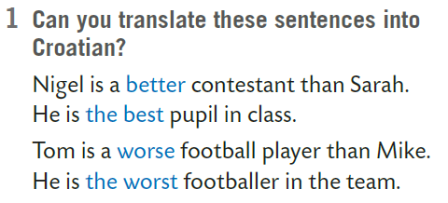
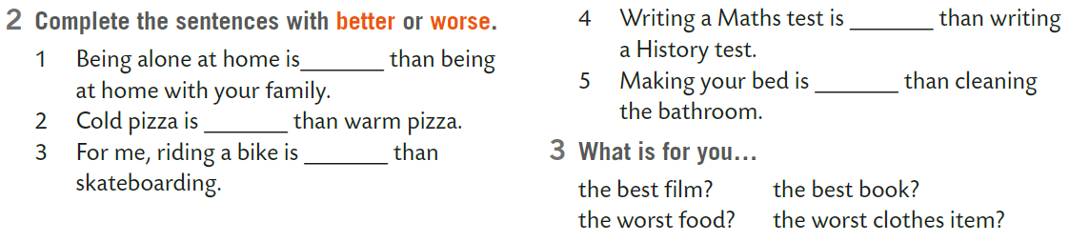
Translate these sentences into Croatian.
Nigel je bolji natjecatelj od Sarah.
On je najbolji učenik u razredu.
Tom je lošiji nogometaš od Mikea.
On je najlošiji nogometaš u timu.
Complete the sentences with better or worse.

Slide 12
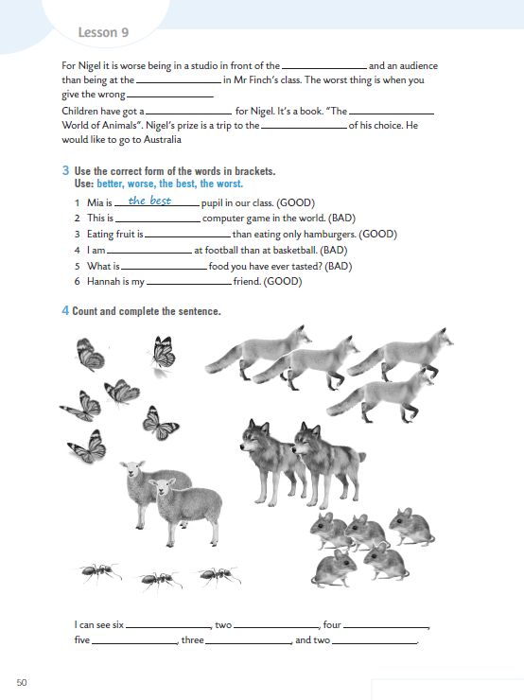
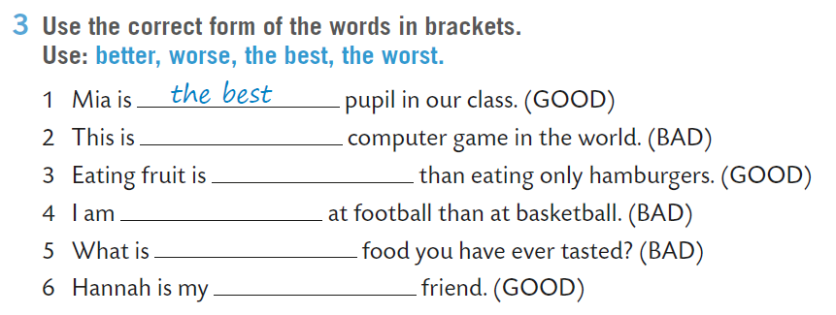
Open your exercise book, page 50.
Use the correct form of the words in brackets.
the worst
better
worse
the worst
best

Slide 13
Which animals can you name in English?
Otvori svoju
tiger
hippo
cat
ANIMALS

Slide 14
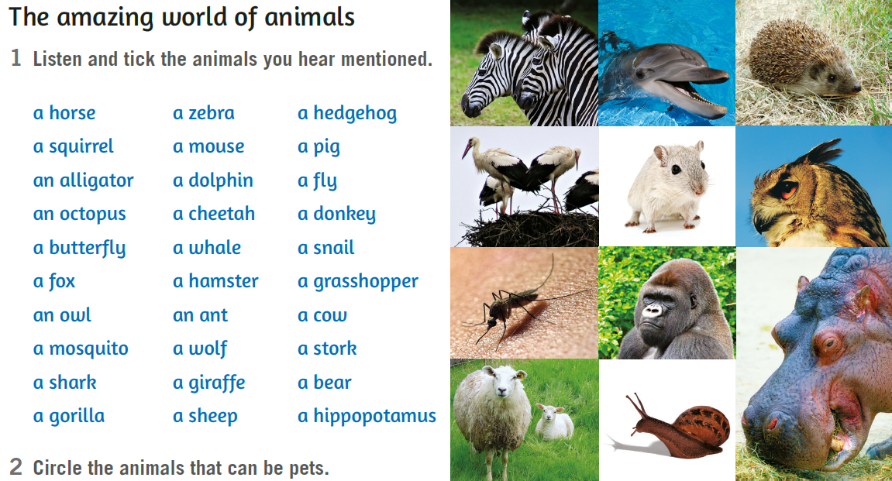
Book, page 56.
Do you know the meaning of these words?
jež
vjeverica
svinja
muha
hobotnica
gepard
magarac
leptir
kit
puž
lisica
hrčak
skakavac
sova
mrav
krava
komarac
vuk
roda
morski pas
medvjed
ovca
nilski konj

Slide 15

Book, page 56.
Listen and tick the animals you hear mentioned.
https://www.e-sfera.hr/dodatni-digitalni-sadrzaji/d874387f-a20c-4100-9055-6481369241f5/assets/audio/26_lesson_9_animals.mp3
Circle the animals that can be pets.

Slide 16
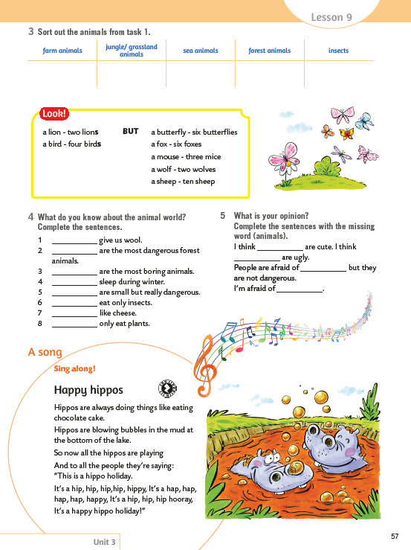
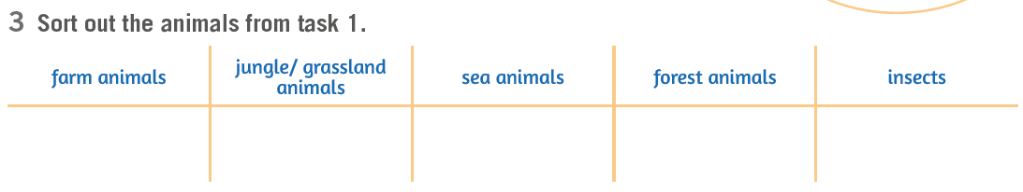
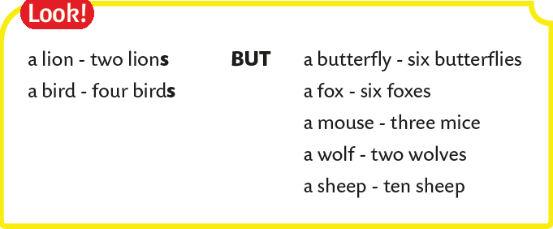
On the next page....
Sort out the animals from task 1.
životinje na farmi / domaće životinje
životinje iz džungle / sa travnjaka
morske životinje
životinje iz šume
kukci
Practice here:
https://wordwall.net/resource/226272/animals
Većina imenica u engleskom jeziku svoju množinu dobiva dodavanjem nastavka –s ili –es, dok se neke mijenjaju, a neke ostaju jednake kao i u jednini.

Slide 17
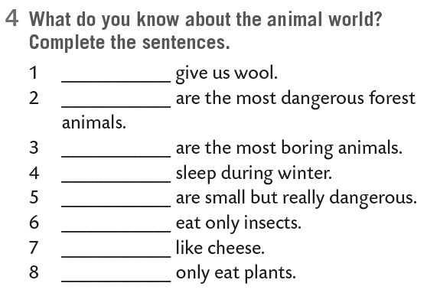
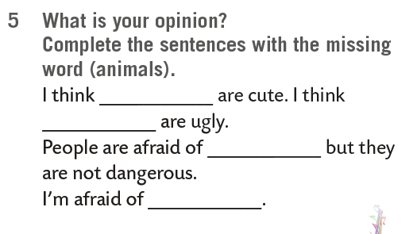
What do you know about the animal world? Complete the sentences.
What is your opinion? Complete the sentences with the missing word (animal).
Sheep
Wolves
Practice here:
https://wordwall.net/resource/275272/engleski-jezik/amazing-world-animals
https://wordwall.net/resource/278879/engleski-jezik/comparative-or-superlative-sort-out
https://www.e-sfera.hr/dodatni-digitalni-sadrzaji/d874387f-a20c-4100-9055-6481369241f5/assets/interactivity/kviz_1/index.html
https://wordwall.net/resource/278880/engleski-jezik/congratulations-nigel

Slide 18
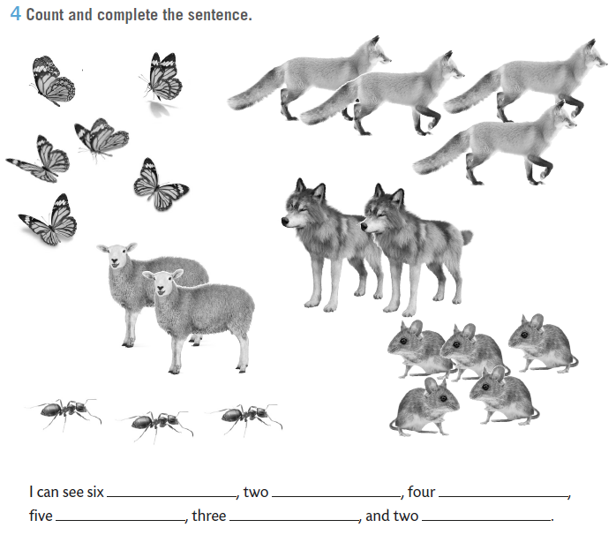
WB, page 50.
Count and complete the sentences.
butterflies
sheep
foxes
ants
mice
wolves

Slide 19
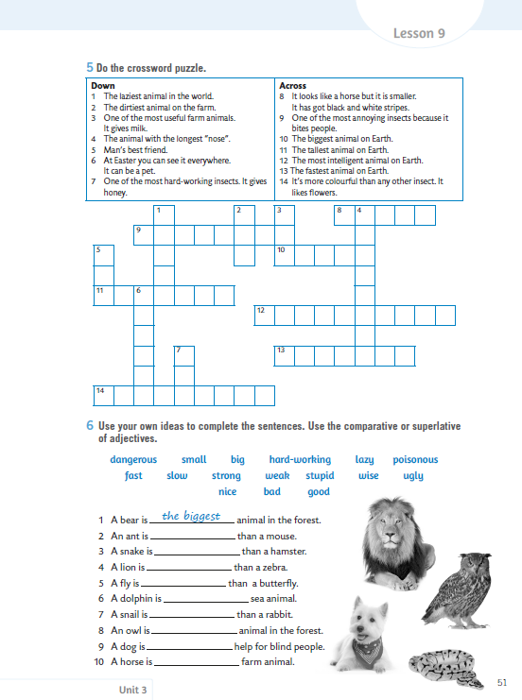
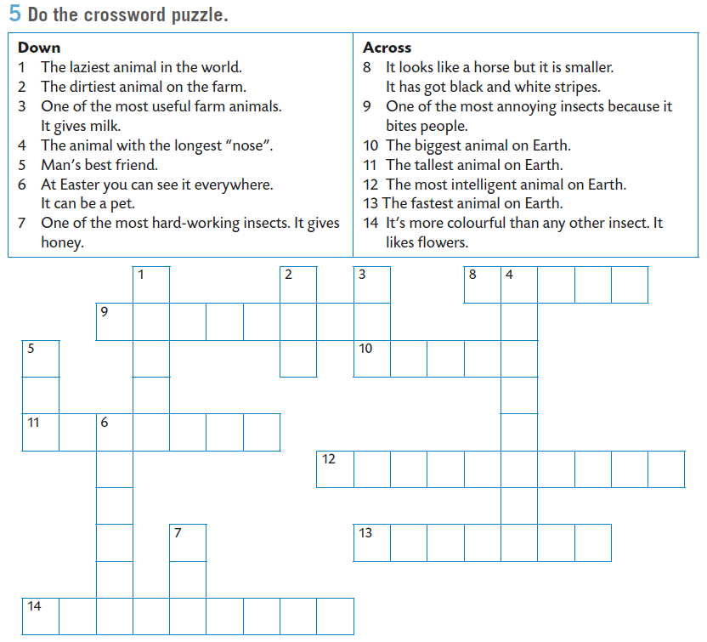
On the next page....
Do the crossword puzzle.

Slide 20
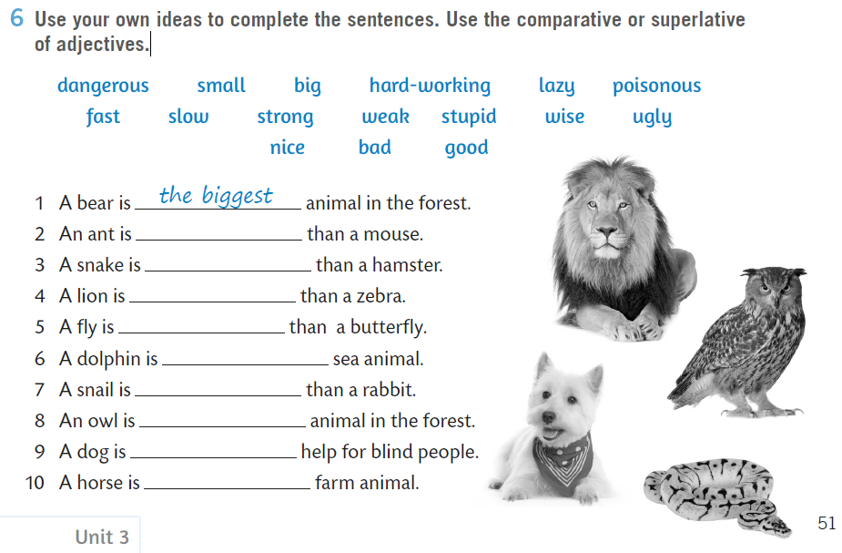
Use your own ideas to complete the sentences. Use the comparative or superlative of adjectives..

Slide 21

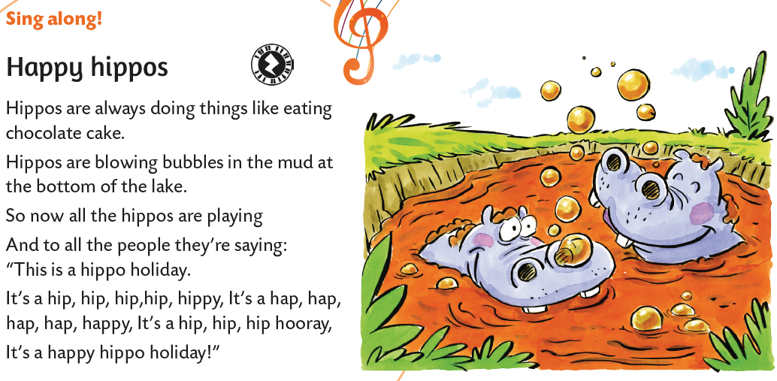
Guess the animal.
It is a big animal.
It can weigh 2-4 tons.
It lives in Africa.
It loves water and mud.
It spends up to 16 hours a day in the water to keep cool.
Open your book, page 55.
Sing along!
https://www.e-sfera.hr/dodatni-digitalni-sadrzaji/d874387f-a20c-4100-9055-6481369241f5/assets/audio/27_lesson_9_a_song.mp3

Slide 22

LEARN MORE!
https://www.e-sfera.hr/dodatni-digitalni-sadrzaji/d874387f-a20c-4100-9055-6481369241f5/
Animals

